Slide 1
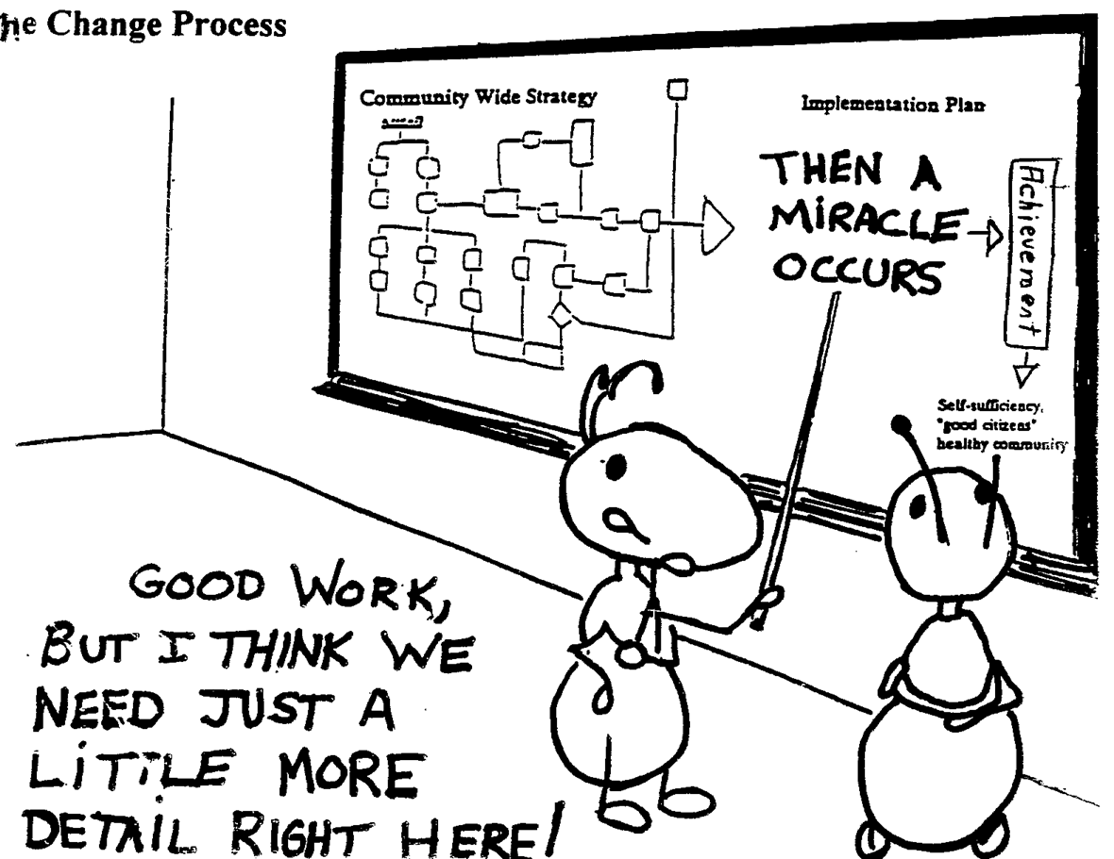
Digital Project Stages: Collection
Notes:
Oftentimes researchers see technology as a magic elixir and it clouds the process of doing a digital project and the time that it takes. Though the stages of a digital project are the same as a traditional research project, it’s good to think about these stages one at a time and consider the 3 aspects in each stage.

Slide 2
Three Stages of Digital Project
Collection
Analysis
Publication

Slide 3
Stage One: Collection
Collection is a two-step process:
Preparation
Translation

Slide 4
Turning Information To Data
Things to consider before making data:
1) How might you structure the information
2) What do you want to analyze in the information
3) How do you want to communicate your analysis
Notes:
Even the most programmatically advanced digital project starts with good data. A constructing good data is a multi-step, iterative process of understanding the potential of your information, what you want to analyze in it, and how you want to communicate that analysis. These steps build off each other, but depending on the state of your information, you might know how to structure it into data, in which case step 2 & 3 become more important in helping you figure out that structure.

Slide 5
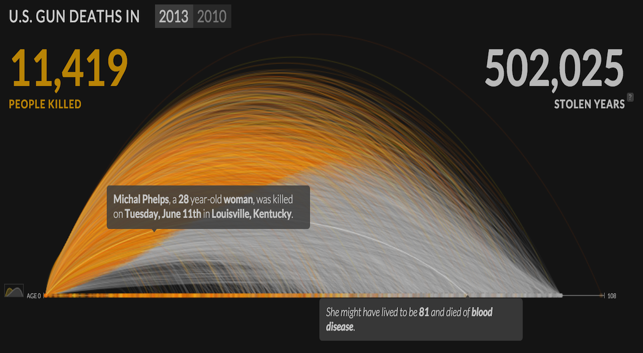
Getting Started With Humanities Data
http://guns.periscopic.com/?year=2013
Notes:
My first exposure to this visualization was when a professor showed it to me as an example of something he would like to do with his research on refugees. This is a common occurrence, and a valid way to begin working on a Humanities data project. I am often approached to do a project that begins with examples like this or involves a researcher who has collected data but who is not sure what to do with it. Based on those encounters, we know how hard getting started on one of these projects can be if working with structured data is new or foreign to you and the role of technology in this kind of work is unclear.
In this workshop, we will attempt to make this process more clear by looking at the data behind a few digital projects and by walking you through a few Humanities projects we’ve worked on. Our hope is that you leave this workshop with a better sense on ways to approach structuring your data to facilitate working with a technologist/specialist so you can take your project to the next level.

Slide 6


Behind The Viz
1) Structure:
gun death by name, age, gender, location, date
2) Analyze:
gun deaths by age
3) Communicate
compare actual age of death to what could have been age of death if not for gun violence
Notes:
Take our opening example, how has the analysis and the way it’s communicated affect how we structure the information driving the Viz?

Slide 7
Translation
Is: taking information that is informal and unstructured and making it fit into a rigidly formal and structured medium.
Goal: Make it possible for a computer to read your sources.
Notes:
Answering these 3 questions is part of the translation process. Translation is the process of going from the qualitative info your sources often provide to quantitative data that the computer can count and read. Try doing the translation exercise for the gun violence example on the opening slide.

Slide 8
Information 1
Birmingham police officer's father killed in shooting, 2 in custody
Posted: May 06, 2013 10:46 AM EDT
Updated: May 13, 2013 10:46 AM EDT
By Melynda Schauer
Birmingham police are investigating a homicide that happened Monday morning in the southwest part of the city. Police say a man was shot at 209 3rd Avenue SW near Zion Star Missionary Baptist Church around 9 a.m.
Police identify the victim as Birl Jackson, 76. Jackson was the father of a Birmingham police officer and had been a deacon at Mt. Calvary Baptist Church in West End for almost 40 years, according to members of his church. Jackson had been making a living cutting grass and maintaining lawns for decades. He was on the job with two of his grandsons when he was shot near his truck Monday morning.
A neighbor says he heard several gunshots and came outside to see the victim slumped over his truck. Jackson was rushed to UAB Hospital where he was pronounced dead.
Birmingham police think robbery may have been a motive in the shooting.

Slide 9
Information 2
18-year-old found dead in north Montgomery victim of city's 42nd homicide
By Erin Edgemon
October 23, 2013 at 10:25 AM, updated October 23, 2013 at 10:28 AM
Montgomery police is investigating the fatal shooting of 18-year Jevonte Scott as the city’s 42nd homicide of the year.
Scott was found dead of gunshot wounds in the backyard of a residence in the 100 block of Cedar Street at around 11 a.m. on Tuesday, Montgomery police released.

Slide 10
Information 3
Father, baby son shot dead in Oakland
By Henry K. Lee, Justin Berton and Kurtis Alexander
Updated 11:20 pm, Wednesday, August 7, 2013
An 8-year-old girl at a sleepover. A pet sitter driving through her neighborhood. And now, a father and his 1-year-old son, in Oakland for a slain relative's funeral and sleeping in a bedroom filled with children.
The latest horror to visit a city already reeling from gun violence happened early Wednesday, when someone opened fire through the window of an East Oakland home where 17 members of an extended family were staying. When the shooting stopped, 20-year-old Andrew Thomas lay dying near his 1-year-old son, Drew Jackson. The boy, mortally wounded, died before sunrise at a hospital.
Unlike the July 17 killing of young Alaysha Carradine and the fatal shooting a week later of Judy Salamon in her car, police think someone set out to kill Thomas. But even longtime investigators were shocked that someone would fire indiscriminately into a bedroom where four children were sleeping.
"It's absolutely unacceptable that we have children being shot while they sleep in their bed," said interim Police Chief Sean Whent. "It is horrific."

Slide 11
What’s Your Data Look Like?
id | date | name | age | city | state | address | time | vsex
1 | 5/6/13 | Birl Jackson | 76 | Birmingham | AL | 209 3rd Avenue SW | ~ 9AM | M
2 | 10/23/13 | Jevonte Scott | 18 | Montgomery | AL | 100 block of Cedar Street | ~11AM | M
3 | 8/7/13 | Andrew Thomas | 20 | Oakland | CA | East Oakland | early Wednesday | M
4 | 8/7/13 | Drew Jackson | 1 | Oakland | CA | East Oakland | early Wednesday | M
5 | 7/17/2013 | Alaysha Carradine | 8 | Oakland | CA | ? | ? | F
6 | 7/24/2013 | Judy Salamon | ? | Oakland | CA | ? | ? | F
Notes:
Our new-formed data leaves us with some issues that computer is going to have trouble with. If we asked the computer to show us the times when gun violence occurs, could it? What if we ask the computer to show us where these events happened on a map? What other kinds of arguments could we make with this data?

